Slide 1

Improve Floorplanning by Reinforcement Learning
r06943082 r06921061 r06921048
彭俊又 陳家暄 李友岐

Slide 2
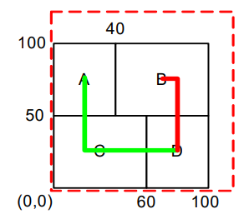
Description
In PA2:Floorplanning, we optimize the result by Simulated Annealing.
However, randomly searching for a better neighborhood solution doesn’t seem to be efficient.
Therefore, we try to apply Reinforcement Learning to this problem.
Cost = αA+(1-α)W

Slide 3
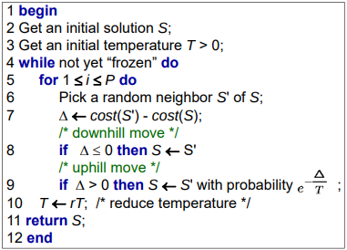
Simulated Annealing

Slide 4
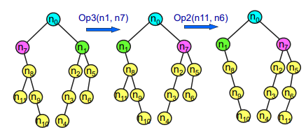
B*-Tree Perturbation
Op1: rotate a macro (same tree topology)
Op2: delete & insert
Op3: swap 2 nodes

Slide 5
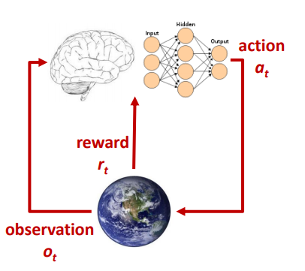
Approach
We compare the floorplanning results of two floorplanners. (α = 0.5)
Solving by SA with pre-tuned parameter. (33% for each operation )
Solving by modifying SA algorithm by replacing the random-move-choose heuristic by RL algorithm and all the other parts remaining the same for fairness.
Parameters：
deadspace
max Width
max Heigth
cool down times
move history

Slide 6
Experiment Results
Case | SA | RL | Rate
ami49 | 20900282 | 20798463 | 0.49%
xerox | 10685270 | 10711632 | -0.25%
ami33 | 695743 | 701885 | -0.88%
apte | 24625345 | 24334181 | 1.18%
hp | 4967235 | 4871160 | 1.93%

Slide 7
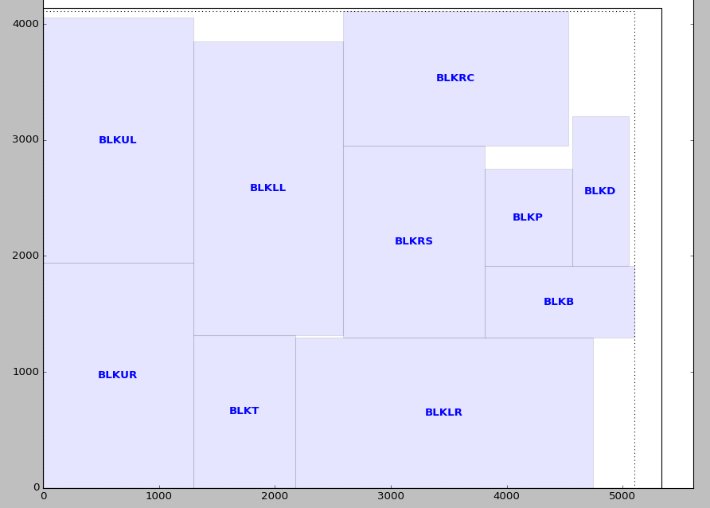
It’s hard to improve in this case

Slide 8
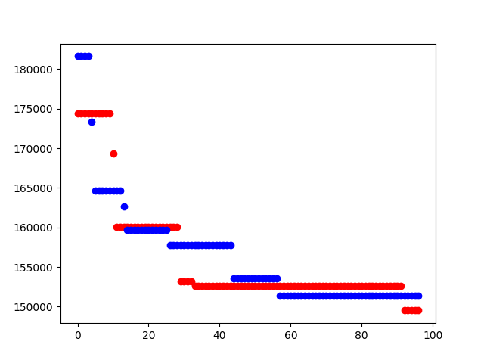
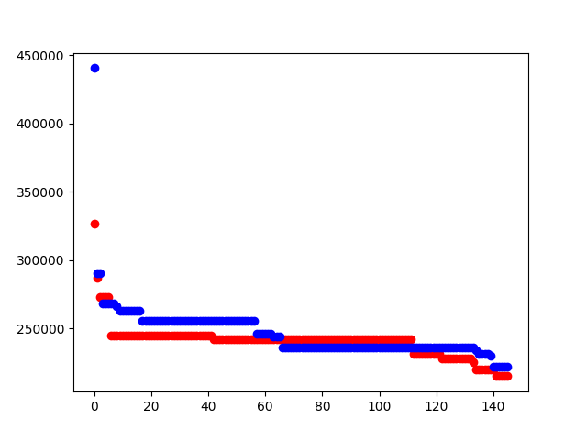
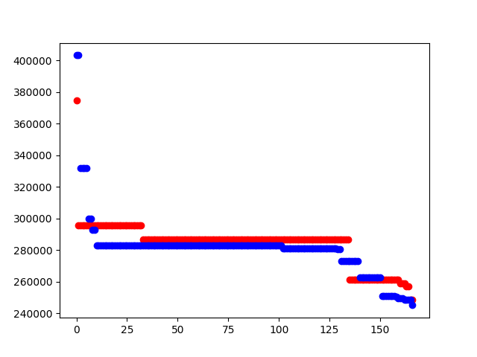
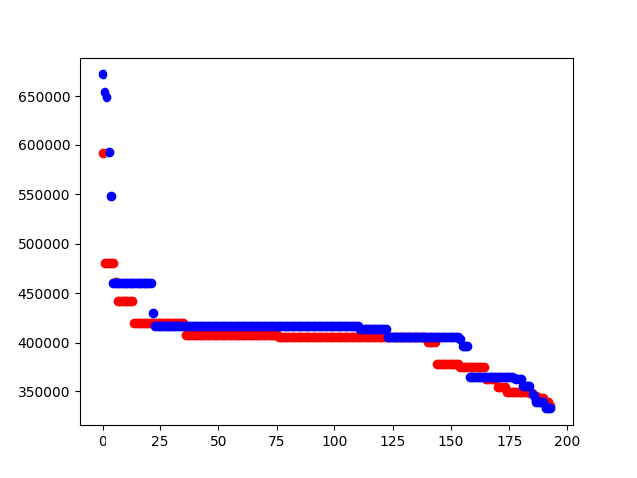
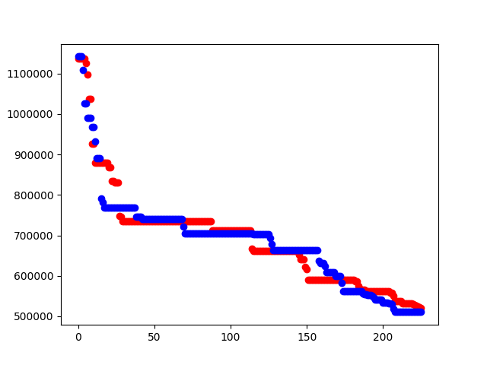

Slide 9
Conclusion and Future Work
Applying RL to choose move doesn’t improve the result significantly.
Picking which move to apply has a little influence on the floorplan result.
Maybe the key is to pick the right macro to move, which can be our future work.

Slide 10

Q&A

